Slide 1
WELCOME
TO

Slide 2
Anesis Hotel is holding a Gold medal in Travelife Sustainability in tourism since 2016.
We would like to inform our guests that Anesis Hotel is following a numerous Sustainable tourism measures for better environment and better working atmosphere to its staff, customers and partners.

Slide 3
Contents
Sustainable Policy
Occupational Health & Safety
Purchasing & Services
Employees & Human Rights
Work Ethics
Donations / Contribution to local community
Energy consumption
Water consumption
Recycle products & consumption
Energy saving information

Slide 4
Anesis Hotel Sustainable Policy
As a hotel we recognize the impact that tourism can have on the natural environment and our community. With this in mind we have adopted a number of policies and procedures to ensure that we minimize our harmful effects on the environment and support our community.

Slide 5
Anesis Hotel Sustainable Policy
Our aims:
1. Energy and Water Management
We will monitor our consumption of water and energy and subsequently set targets to reduce our consumption by ensuring equipment we use is properly maintained, all staff are appropriately trained, and that new technology and ideas are taken on board.

Slide 6
Anesis Hotel Sustainable Policy
2. Waste Management
The hotel will minimize solid waste production in all areas of the hotel, and encourage customers to join the recycling program. Specifically, it will purchase in bulk to avoid excess packaging, minimize the use of paper and plastic for customers and aim to recycle all glass, paper, cardboard, oils, plastic and food waste. Wherever possible, the hotel will avoid the use of chemicals. It will ensure safe disposal of all chemicals that are in use and work towards minimization.

Slide 7
Anesis Hotel Sustainable Policy
3. Promotion of Responsible Tourism in the Area
The Hotel will work and support with local community by ensuring that we purchase and promote produce from the local area wherever possible.

Slide 8
Anesis Hotel Sustainable Policy
4. Donations and Charity
It is the policy of the Hotel that whenever items such as furniture or linen are no longer suitable for use within the hotel, it will offer these items to the local community. The hotel will also carefully consider how it may help the local community by the provision of in-kind support, such as auction prizes, etc. It may also consider sponsorship of local sports teams, provision of meeting space at subsidised or no costs, or advertising space for local businesses.

Slide 9
Anesis Hotel Sustainable Policy
5. Employment
The hotel recognizes the importance of recruiting local people as employees. We believe our employees are our greatest assets, and recognize our ethical as well as legal responsibilities to take care of them. We believe that by treating our employees well, they in turn will continue to take the very best care of our customers. We strive to ensure we do not discriminate in any way and welcomes all staff regardless of their race, age, sex, nationality, disability or religion. Throughout the period of their employment, all staff will have a contract that meets as a minimum the regulations as stipulated by national law. We ensure that all new employees are provided with appropriate induction and training. This will cover such areas as company philosophy and culture, product knowledge, employee welfare and benefits, heath and safety, performance management, etc.

Slide 10
OCCUPATIONAL HEALTH AND SAFETY POLICY
The Management of ANESIS HOTEL will comply with all of its legal duties in pursuance of providing safe and healthy working conditions for all employees and a safe and healthy environment for its customers.
In addition the Management will co-operate with all with an interest in health and safety, tourist agents, suppliers, sub-contractors and the enforcing authorities.
The hotel Management is committed to maintain and implement an Occupational Health and Safety Management System which is in accordance with the International Standard OHSAS 18001:2007.

Slide 11
OCCUPATIONAL HEALTH AND SAFETY POLICY
Heads of departments are committed to ensure that safe working practices are being carried out in their departments.
For this purpose a health and safety Committee has been formed.
The Management will ensure that all personnel is competent to carry out
their duties, and will provide all information, instruction, supervision and necessary training.
The assurance of a health and safety work environment is been achieved by encouraging all personnel to participate in OH&S activities.
This policy will be kept up to date and will be amended to suit any changes in the size or nature of hotel’s activities. In support of this intent the policy will be reviewed annually.

Slide 12
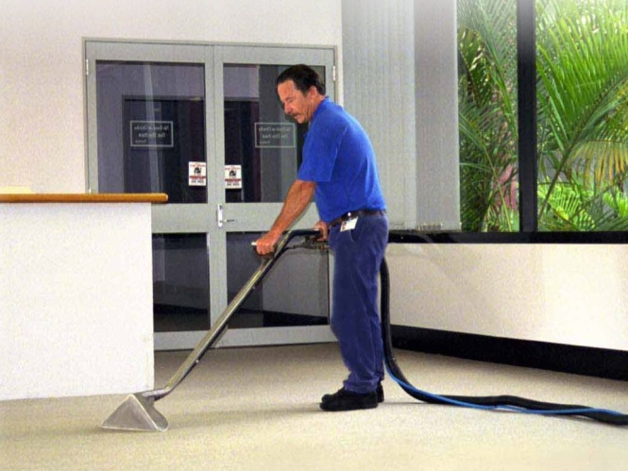
Purchasing & Services
Our main objective when we buy supplies and services is to give priority to the local area and region.
65 % of our supplies and services come from Famagusta area.

Slide 13
Employees
Anesis Hotel has 60 % of local employees and 40 % foreign employees. We make sure that all our employees receive the appropriate training in order give the appropriate attention to our customers. We focus on team work which is the most successful way to achieve our goals.

Slide 14
Work Ethics
Hotel Industry it’s all about team work
In Anesis Hotel we work as a team and helping each other to achieve a common goal.
We strive to deliver good quality service to our guests and also to improve our skills and learn new things concerning the work environment.
We assist everyone despite gender, age, race, nationality and religious believes, education, social status, disability, appearance, sexual orientation.

Slide 15
Statement of Commitment to Human Rights
At Anesis Hotel we strive to provide a safe workplace where the human rights are respected in accordance with the collective agreements with the unions and the applicable legislation.
We are an equal opportunity employer and we support the protection of human rights, particularly those of our employees, the parties we do business with and the community where we operate.
In particular, our hotel is committed to the following:
Respect and foster labor-related human rights, including non-discrimination, health & safety and fair wages.
All new employees are informed before they start work about the terms and conditions of their employment, including pay and welfare arrangements.
We prohibit hiring of young workers (below 18 years of age) to perform any type of work that is likely to jeopardize their health, safety or morals.
Respect children’s rights and have zero tolerance of violence, any form of exploitation and abuse of children, including but not limited to sexual exploitation.
All allegations of children exploitation will be taken seriously and investigated. Serious allegations will be reported to the relevant authorities.
Communicate both internally and externally the risks related to children’s rights.
All staff working with children receives regular, ongoing training.
We expect that all hotel employees, suppliers and other business partners will respect human rights including children’s rights.

Slide 16
Donations / Contribution to local community
Every year Anesis Hotel is donating money or other supplies to various institution, schools and other centers who supports kids with special abilities as well as local festivals
Year Donations
2015 = 30 %
2016 = 20 %
2017 = 60 %`

Slide 17
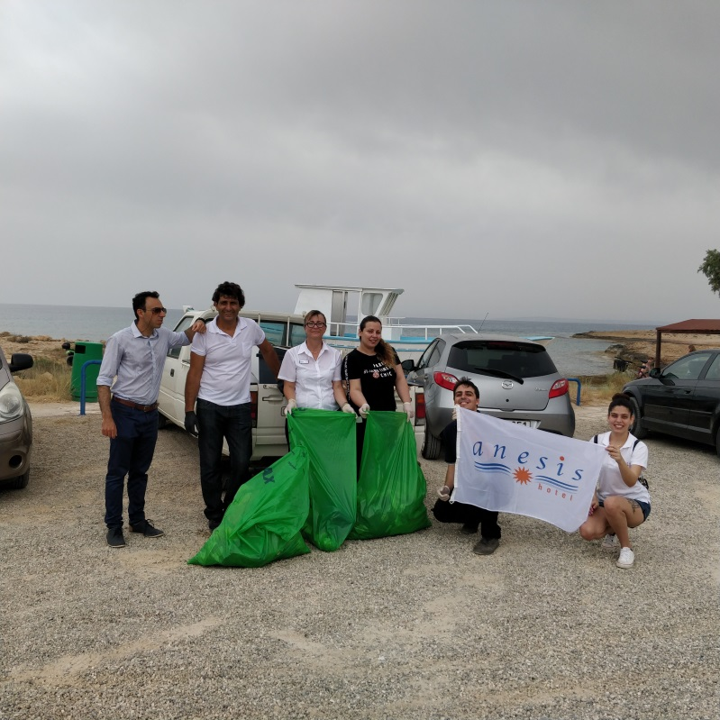
Donations / Contribution to local community
Anesis Hotel staff cleaning Ammos tou Kampouri Beach

Slide 18
Energy Consumption
Electricity (kWh per guest night)
2015 = 10.43 / 2016 = 8.76 / 2017 = 8.19
Petrol (kWh per guest night)
2015 = 2.36 / 2016 = 1.71 / 2017 = 1.47
Gas (kWh per guest night)
2015 = 0.94 / 2016 = 0.73 / 2017 = 1.01
Total Energy Consumption
2015 = 13.73 / 2016 = 11.20 / 2017 = 10.67

Slide 19
Water Consumption
Water (Liters per guest night)
2015 = 230
2016 = 220
2017 = 200

Slide 20
We would like to inform you that the hotel is taking very seriously the environmental policies. Please be aware about the products that we recycle in the hotel.

Slide 21
Glass
2015 = 1200kg
2016 = 1800kg
2017 = 2400kg

Slide 22
Plastic
2015 = 600kg
2016 = 400kg
2017 = 950kg

Slide 23
Paper
2015 = 840kg
2016 = 1050kg
2017 = 1330kg

Slide 24
Ink/ Toner
2013 = 20 kg reduced carbon
2014 = 22 kg reduced carbon
2015 = 14 kg reduced carbon
2016 = 23 kg reduced carbon
2017= 35 kg reduced carbon

Slide 25
Disposal lightbulbs
In all area of the hotel we use led bulbs that save energy.

Slide 26
Cooked Oil
2015 = 460 kg
2016 = 600 kg
2017 = 270 kg

Slide 27
Bottle Stopper

Slide 28
Batteries
2013 = 20 kg
2017 = 25 kg

Slide 29
FOOD WASTE
Municipality food waste programmed started in 2018

Slide 30
Dear valued guest
Water has become very precious especially for Cyprus
Please decide for yourself
A towel on ‘’rack means…. I’ll use it again’’
A towel on ‘’the floor means…. Please replace’’
Thank you very much

Slide 31
Уважаемые Гости
Во всем мире вода стала драгоценной и особенно на Кипре
Пожалуйста обратите внимание
Полотенце которое весит на вешалке значит ‘’я буду еще пользоваться’’
Полотенце которое лежит на полу значит ‘’пожалуйста поменяйте’’
Спасибо большое

Slide 32
Dear valued guest
Every time that you leave your room do not forget to take with you, your room card.
Thank you for your cooperation

Slide 33
Dear valued guest Use water responsibly. Every drop counts Thank you for your cooperation

Slide 34
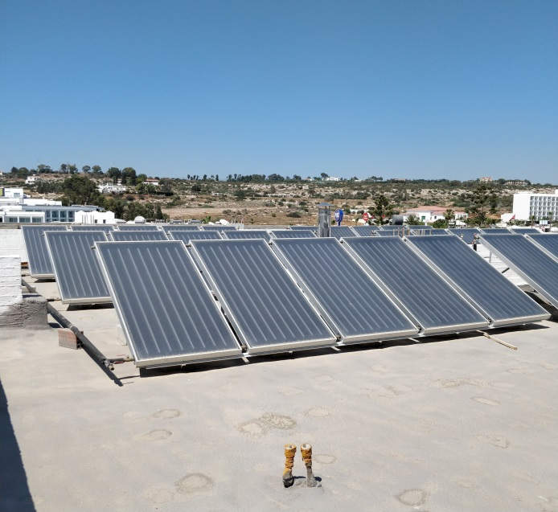
In Anesis Hotel we use solar panels to heat the water
And we are classified as a category B hotel

Slide 35
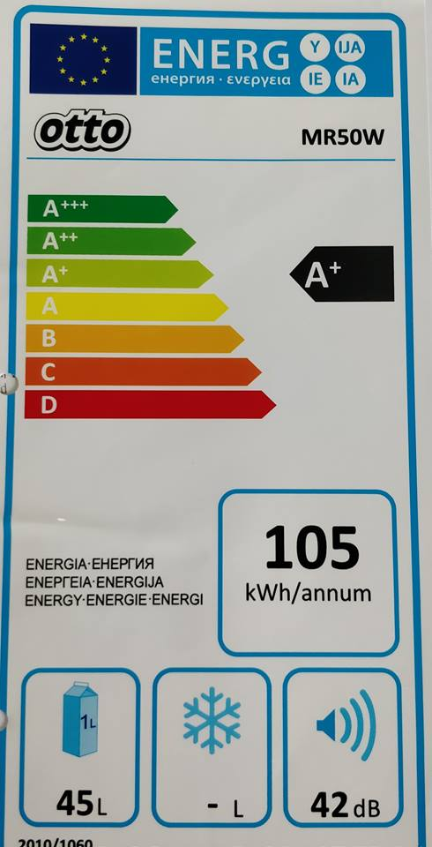
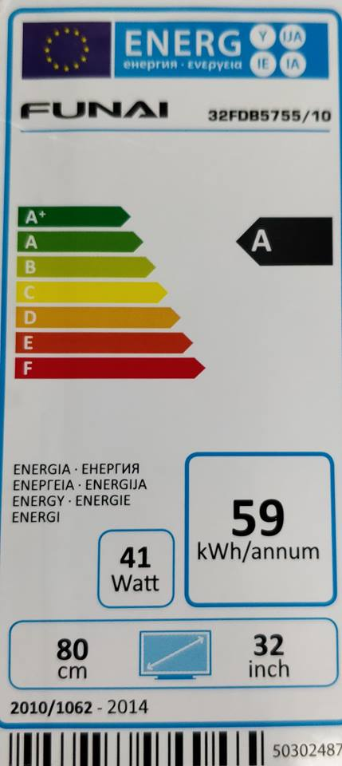
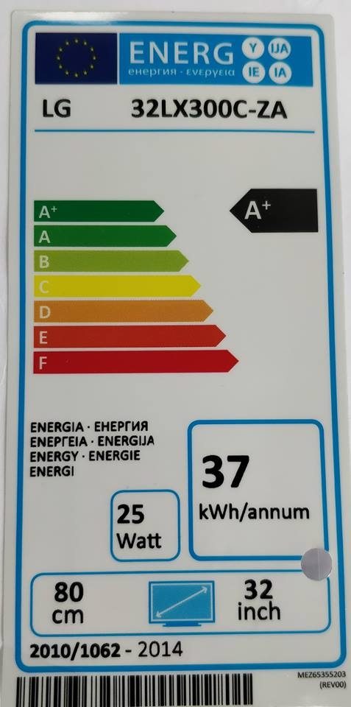
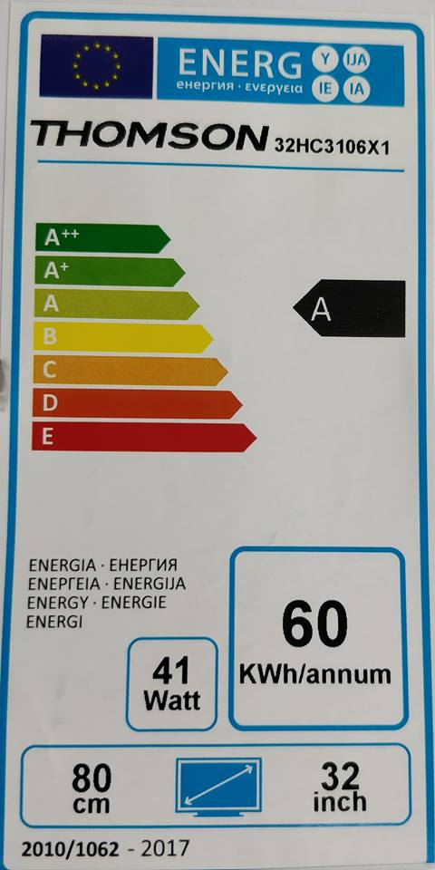
TV & FRIDGES
All our Televisions and fridges use A & A+ ENERGY EFFICIENCY

Slide 36
Thank you for cooperation

